Slide 1
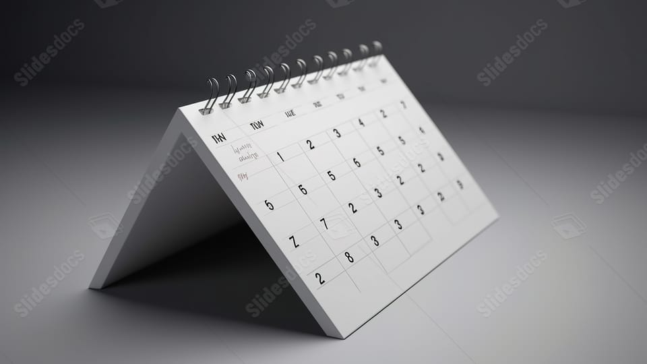
TECHNOVA EVENT SCHEDULER

Slide 2
Table of contents
Project Description
Problem statement
Objectives
Technologies to be used
Methodology for task scheduler
Algorithm
Future enhancements
Conclusion
Outcome
References

Slide 3
Project Description
This project aims to develop a tailored application to optimize event organization processes.
Features:
1.Scheduling
2.Communication Hub
3.Attendance Tracking
4.Conflict Resolution
Impact: Efficient, organized events for Technova

Slide 4
Problem Statement
Event management process within the Technova society is becoming Demanding as:
1. The addition of new clubs into the society. To host and manage the events that are rising day by day a proper system of voting and an application to manage the dated events is required
2. To view events dynamically with the help of a Calendar system and the final acceptance of the Technova President is required to solve the problem of scheduling and managing the events with visual representation of the date been taken
3. to have proper records of each club events that took place for future needs of both academics and representation of presidents tenure

Slide 5
Objectives
Efficient Event Management: Focus on user-friendly application for streamlined event organization. Features include seamless scheduling, coordination, and execution
Data Storing: Comprehensive feature for tracking key Events. Ensures accurate records and aids in better planning and resource allocation.
Visual Approach: Visually appealing interface that can easily represent scheduled events of the clubs as required
User Integration: Integration with popular event and community platforms for expanded outreach and engagement
Security and Authorization: Encapsulation through passwords

Slide 6
Technologies to be used
Platform (Python)
GUI( Tkinter)
Pythons Libraries (Hashlib, OS, DateTime, TkCalendar)
Storage (.json)

Slide 7
Methodology for Task Scheduler
Requirements Analysis:
To initiate the project, a comprehensive analysis of functional requirements was conducted. Key features identified included month selection, dynamic calendar display, event entry, and addition functionalities. This phase aimed to define the scope and specifications of the application based on user needs.
Environment Setup:
The development environment was set up to ensure a consistent and stable platform for coding. Python and the tkinter library were installed, and version compatibility was maintained among team members. The chosen development tools provided an efficient workspace for the coding process.

Slide 8
GUI Design
The graphical user interface was designed using tkinter widgets. The layout was organized to offer an intuitive and visually appealing experience for users. Elements such as labels, option menus, entries, and buttons were strategically placed to facilitate seamless interaction.
Calendar Display Logic
The logic for dynamically generating and displaying a calendar for the selected month was implemented. The algorithm determined the number of days in the chosen month, and labels were dynamically generated for each day. Existing events for each date were retrieved and displayed beneath the calendar.
Event Handling
Mechanisms for handling events, including the addition of new events, were implemented. User inputs were validated to ensure data integrity, and appropriate feedback was provided through warning messages or success notifications. For simplicity in this demonstration, an in-memory storage approach was employed.

Slide 9
Data Storage:
Event storage was simulated using an in-memory dictionary. While this approach is basic and limited to demonstration purposes, it allowed for the development of core functionalities without the need for external databases or more complex storage solutions. Although we might still try to connect the database through RDBMS or cloud storage.
Testing:
GUI testing and user acceptance testing are to be conducted to ensure that all components of the application functioned as expected. Identified issues were promptly addressed and resolved.

Slide 10
Algorithm
Import necessary libraries such as calendar, tkinter etc.
Define a class to encapsulate the functionality of the application.
In the method inside a class say _innit_
Initialize the Tkinter root window and set its title.
Create variables to hold the input values for year, months and Events.
Create labels, entry widgets, and buttons for year, month, task functionality.
Initialize an empty dictionary to store tasks and their corresponding Information
Define a method to handle the Add Event functionality:
Retrieve the task and input by the user.
Add the task to the dictionary initialize above if it doesn't exist, or update its information if it does.
Reset the entry fields.

Slide 11
XII. Handle the case where the date input is not a valid integer.
XIII. Define a method to display the calendar with events and colors.
XIV. Retrieve the year and month input by the user.
XV. Generate the calendar text using the function(tkcalendar).
XVI. Append event details from the dictionary to the calendar text.
XVII. Display the calendar text in the Show All Events label.
XVIII. Handle the case where the colour is not valid.
XIX. This algorithm allows users to interact with the GUI to input year, month, tasks, and vote counts, and then displays a calendar along with the entered tasks and their vote counts for the specified month and year.

Slide 12
Future Enhancements
Enhancements:
1.Consider integrating date pickers and persistent storage solutions.
2.Feedback and evolving requirements to guide future iterations.
Deployment:
1.Ensure compatibility across different systems.
2.Explore packaging options for simplified distribution.
User Training and Support:
1.Outline plans for user training and support.
2.Prepare documentation and training materials.
Establish a support system for addressing user inquiries and issues post-deployment.

Slide 13
Conclusion
This project, developed using Python and GUI modules like Tkinter and Pygames, aims to maximize the efficiency of event management process within the Technova Society. By simplifying scheduling processes and reducing resource requirements, it promises significant time and efficiency gains. Through features like exclusive presidential decision-making, the application ensures streamlined operations and enhances event planning accuracy. Additionally, its intuitive interface facilitates records of the current months scheduled events, fostering better organization and decorum in event management.

Slide 14
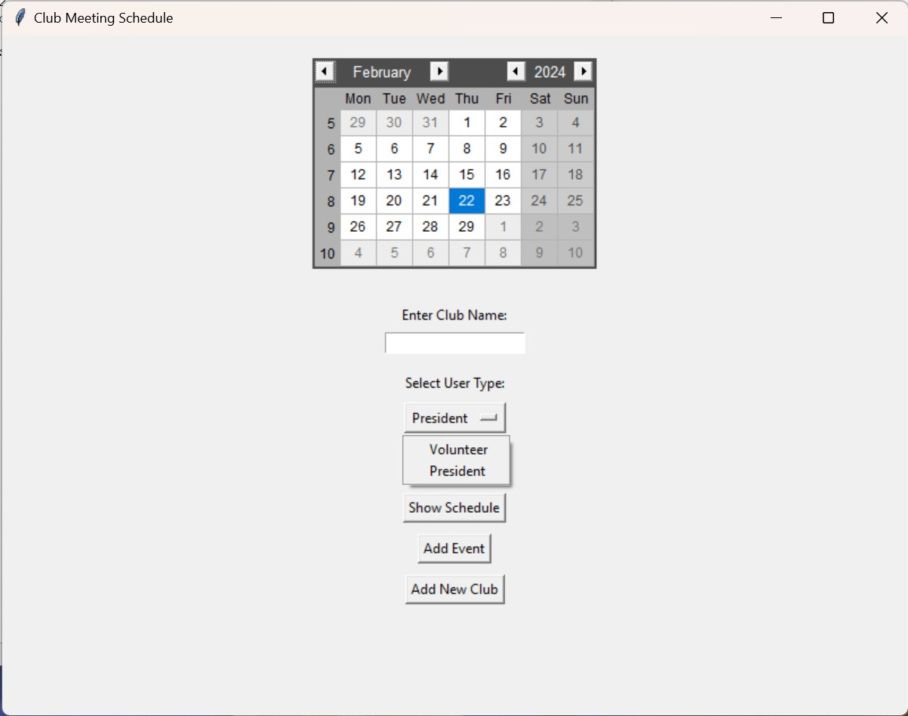
Outcomes
This is the window containing the very first model of our calendar and application.
It consists of:
Clubs entered during execution
User type selection
All events option
Add new events (President Login Required)
Add new Club (President Login Required)

Slide 15
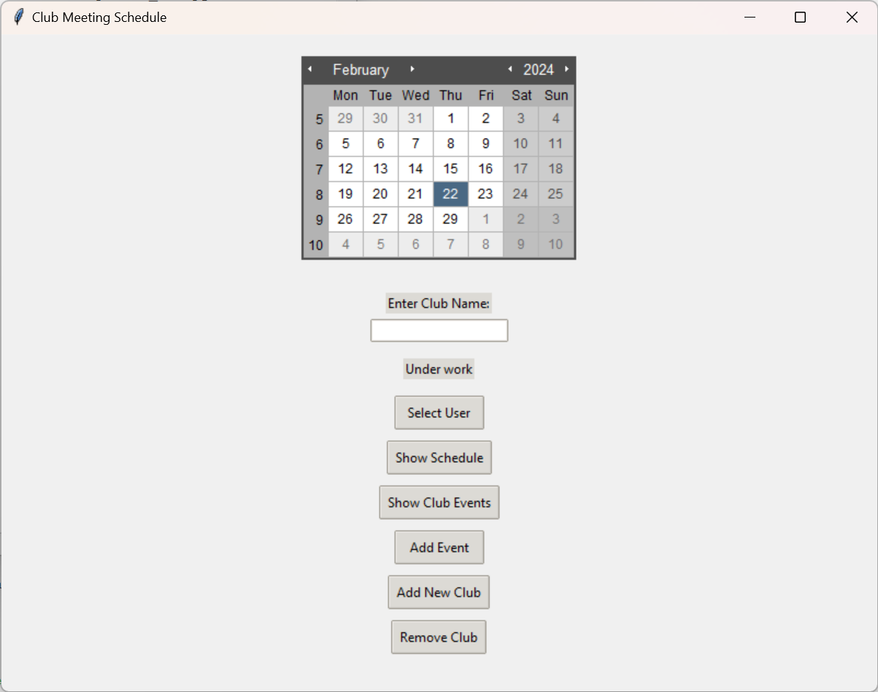
Improved the code such that
Searching was made possible
User Selection and other options got an upgrade to the looks
Implemented logic to ‘Remove Clubs’

Slide 16
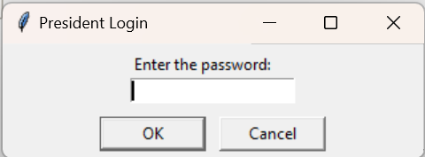
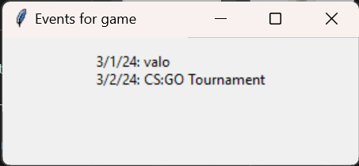
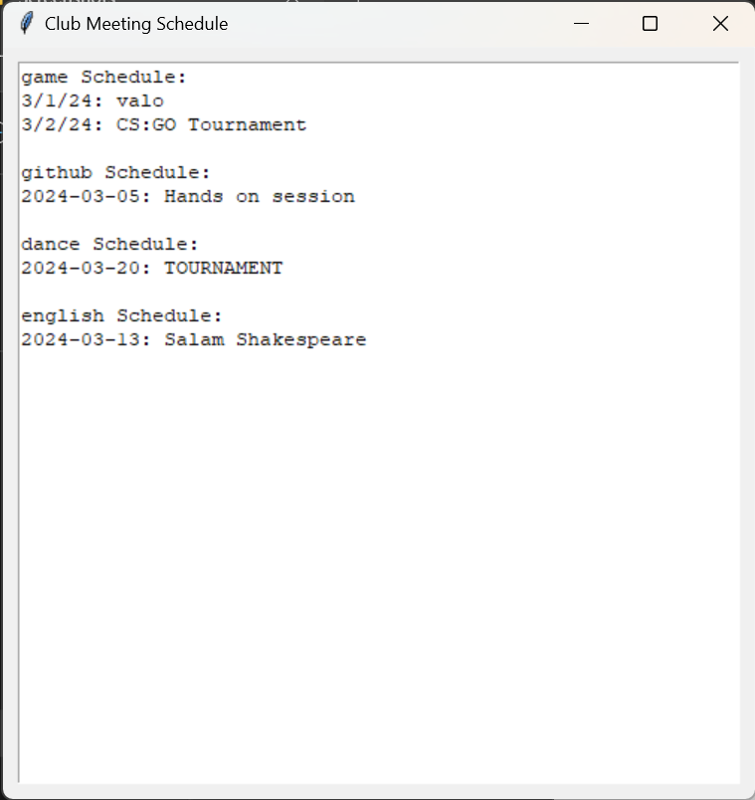
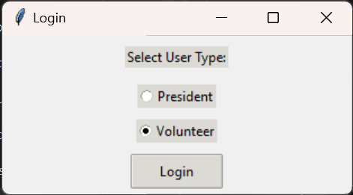
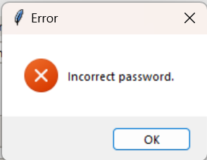
Prompts

Slide 17
Login Prompts
Club Specific and All Registered events display windows

Slide 18
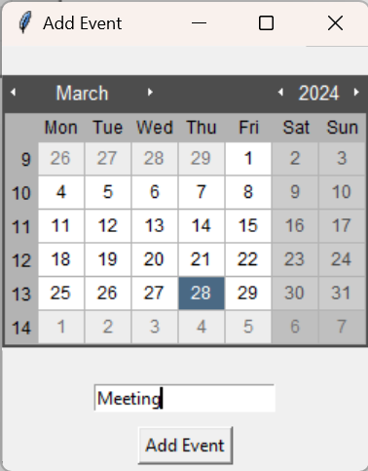
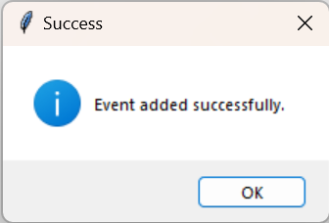
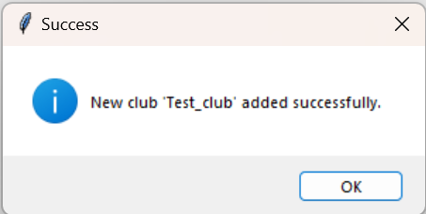
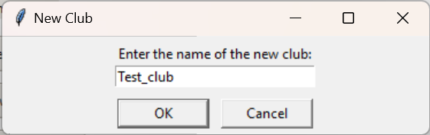
New Event Addition
New club Addition

Slide 19
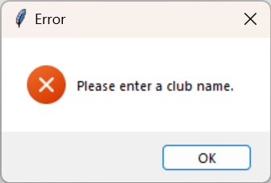
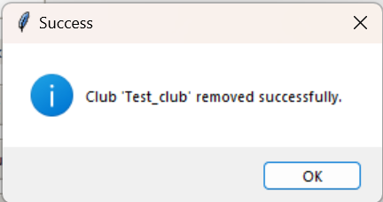
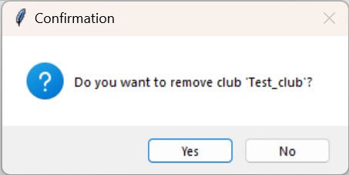
All other confirmational prompts

Slide 20
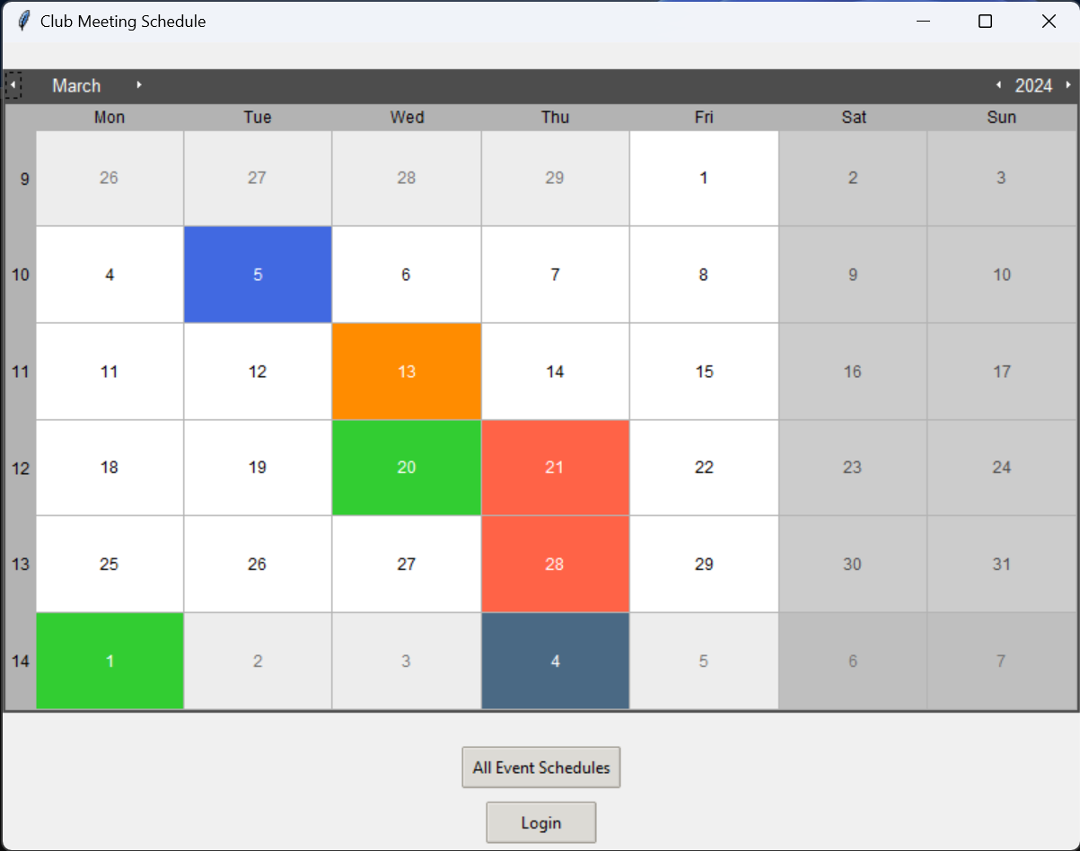
Final results
The latest implementations are:
Better logic to define and navigate through the Calendar
Interactive Dates
Dates with colours representing the scheduled events of particular club
New logic to login into President panel
An option to show all events should primarily be available

Slide 21
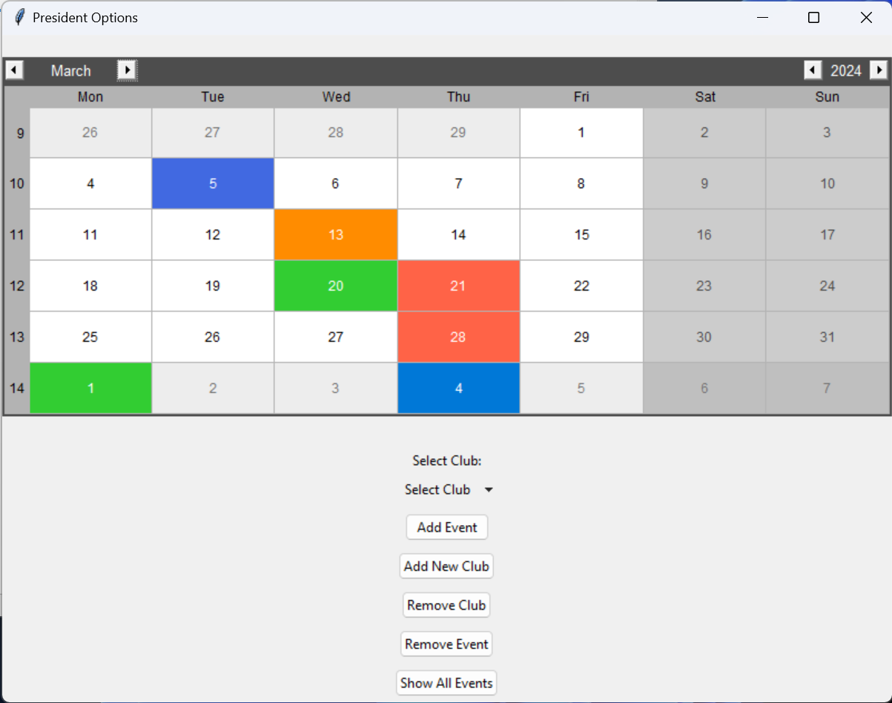
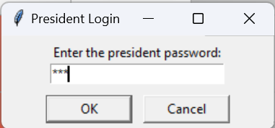
Club 1
Club 2
President Panel (Window)
Logic to show respective color of clubs, for each club
Club 3
NOTE:
To login into the President Panel, one must be authorized or should know the credentials
To have a security mesure during password entering, we implemented a hashing system

Slide 22
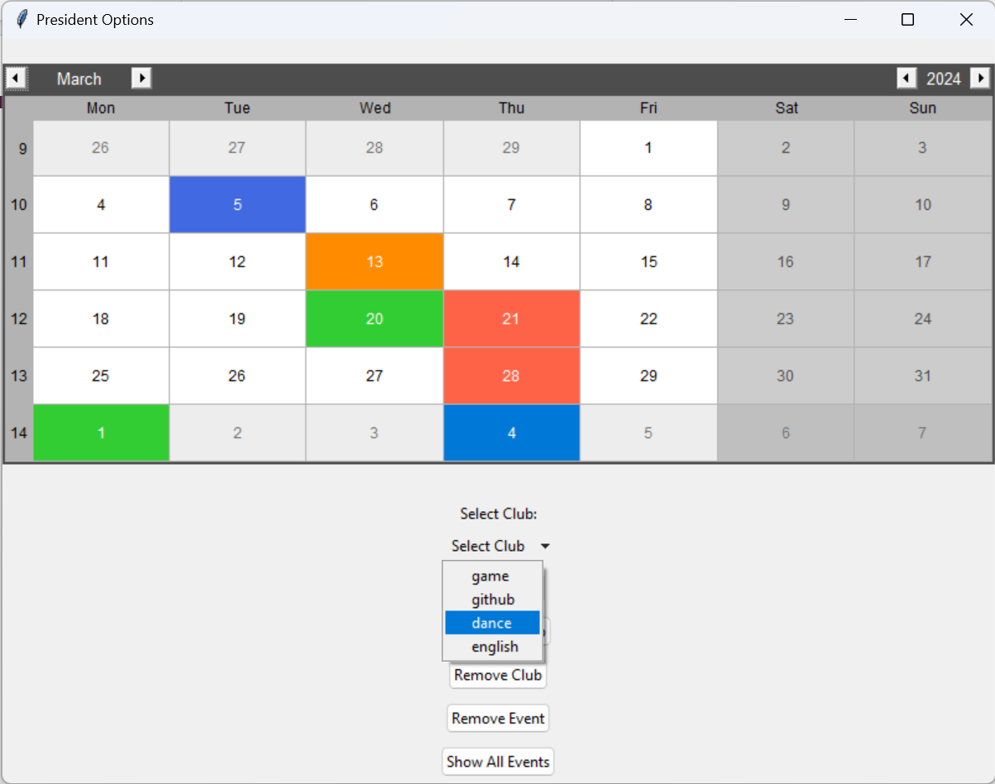
Adding Events
Dance Club (let)

Slide 23

Adding Events
Adding event for Dance Club

Slide 24
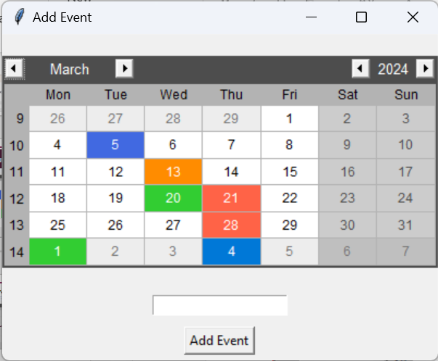
Choose the date of the event by simply clicking on the date of the calendar, which opens in a new window
Type in the name of the event to be registered and press on Add Event

Slide 25
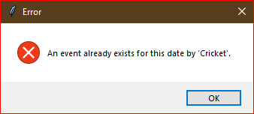
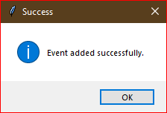
Choose the date of the event by simply clicking on the date of the calendar, which opens in a new window
(In Case the date is preoccupied, a logic is implemented to show which club has preoccupied the date)
Type in the name of the event to be registered and press on Add Event
If date is free then this window will be displayed

Slide 26
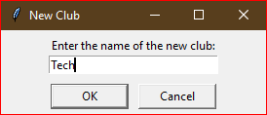
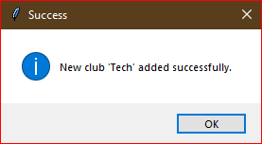

Slide 27
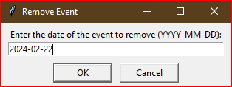
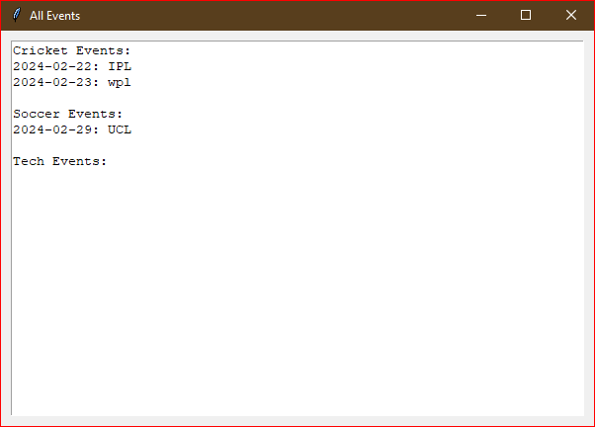
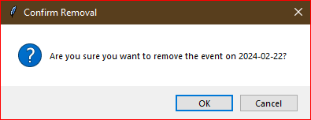
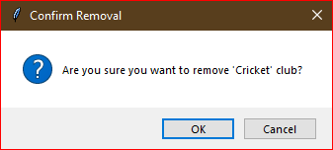

Slide 28
References
1. Beniz, D. a. (2016). In Using Tkinter of python to create graphical user interface (GUI) for scripts (pp. 25-28).
2. Lutz, M. 2. (2001). Programming python. O'Reilly Media, Inc.

Slide 29
THANK YOU

